Slide 1
E-Money Transfer with QR Code Scanner
By: Sushant Sharma

Slide 2
Project: E-money Transfer using Qr code Sensor
QR code scanner: scans and stores the info of a product into a database
QR code is used to:
Save the info → amount of money and description of product
Money → can be sent to anyone

Slide 3
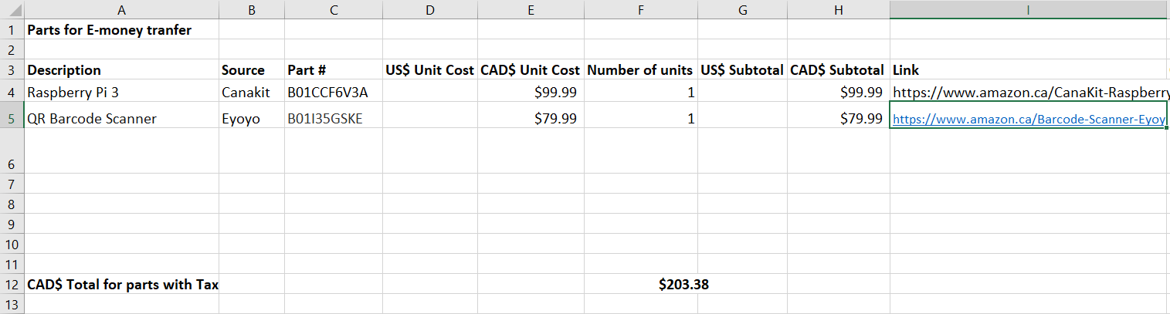
Budget
Purchased a total of 2 items:
Raspberry Pi 3 for $112.98 including taxes
QR Code Scanner for $90.39 including taxes
The total is CAD 203.38

Slide 4
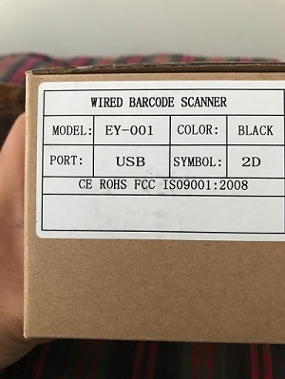
Schedule
Received equipment - October 16, 2017
Worked on soldering PCB and the sensors provided by prototype lab during strike
Started configuring raspberry pi - November 27, 2017
Initiated researched for ways to connect QR code scanner to pi - December 4, 2017
Started on the code so that I can scan and store barcodes and QR codes onto a file.

Slide 5
Build Video/Demonstration

Slide 6
Knowledge utilized from previous courses
CENG 215 Digital And Interfacing Systems: Learned to build circuits
CENG 216 Intro to Software Engineering: Creating Gantt Charts
CENG 252 Embedded Systems: Gained knowledge regarding microcontrollers

Slide 7
Thank You

